Slide 1

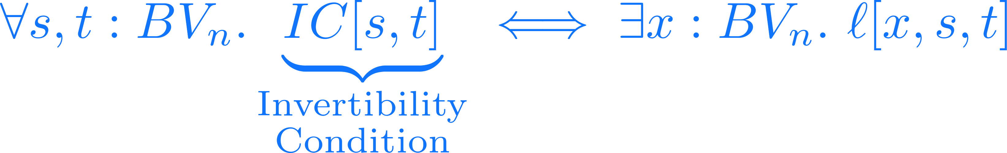
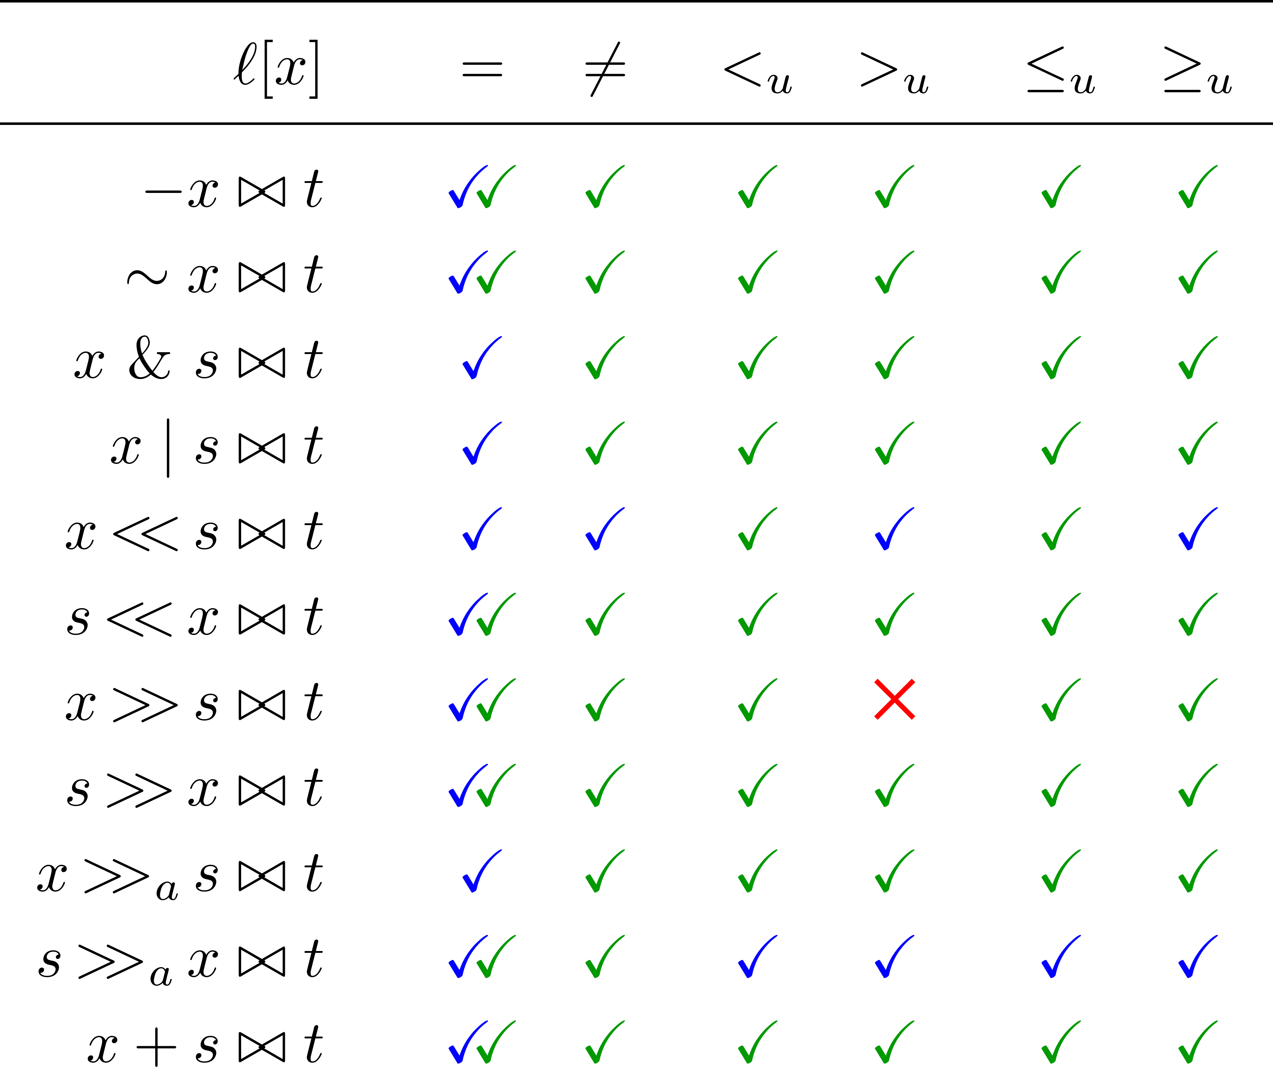




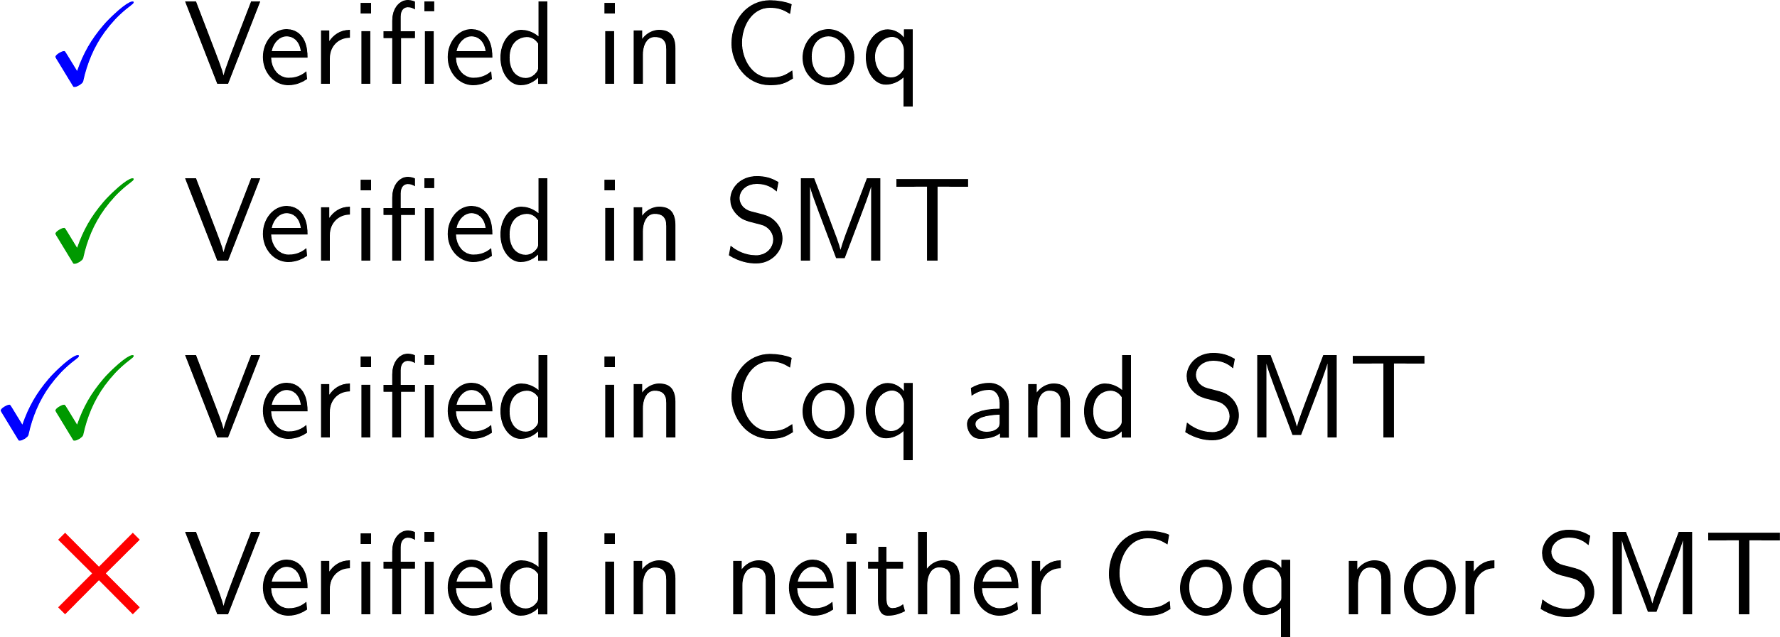



Verifying Bit-vector Invertibility Conditions in Coq
Burak Ekici¹ Arjun Viswanathan² Yoni Zohar³ Clark Barrett³ Cesare Tinelli²
¹ University of Innsbruck ² University of Iowa ³ Stanford University
Contributions
Previous Work
[Niemetz et al., CAV 2018]
generated 162 invertibility equivalences
proved them using SMT-solvers for bit-widths up to 65
[Niemetz et al., CADE 2019]
encoded the equivalences in theories supported by SMT-solvers
verified equivalences for parametric widths
succeeded on ≈75% of the equivalences
This work
formalized a representative subset of the 162 invertibility equivalences in Coq
extended a Coq bit-vector library to support these equivalences
proved 18 of them for arbitrary bit-width
The CVC4 SMT-solver uses invertibility equivalences to solve quantified bit-vector formulas
Proofs of these equivalences for arbitrary bit-widths certify the solver’s results
Examples
Results
Bit-vector Library
Basic Signature
Arithmetic:
Bit-wise logical:
Comparison:
Extended Signature
Comparison:
Shift:
Shifts redefined:
Shift:
Concatenation:
Bitvector Representations
​ | SMTLib[CAV 18]​ | Encoding[CADE 19]​ | Coq Library​(Our work)
Bit-vector Representation:​ | Bit-vector of width n​ One sort for each n​ | Bit-vector of width n​ Translated to NIA and UF​ | Bit-vector of width n​ List of Booleans over 2 layers​
Expressivity:​ | n cannot be symbolic​ | Allows quantification over n​ | Bit-vectors dependent on n​
Verification:​ | Automatic proofs using SMT solvers ​ | Automatic proofs using SMT solvers ​ | Manual proofs in Coq ​ ​
Results​ | Verified all equivalences for n = 1 to 65​ | Verified ≈75% of equivalences​ ​ | Verified 18 equivalences​ ​

